Slide 1
Coloring Graphs
CME4422

Slide 2
Outline
Coloring Vertices
Coloring Maps
Coloring Edges

Slide 3
Some Definitions
A connected simple graph G is called k-colorable if one of k colors can be assigned to each vertex so that no two adjacent vertices have the same color.
If G is k-colorable but not k-1-colorable, then G is k-chromatic, or we say that the chromatic number of G is k. χ(G)=k

Slide 4
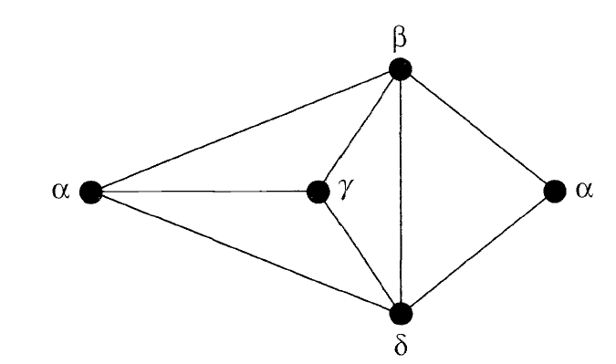
Example: χ(G)=4

Slide 5
Some Chromatic Numbers
χ(K_{n})=n
χ(G_{null})=1
χ(K_{n,n})=2
χ(C_{n},W_{n})=3 where n is odd
χ(W_{n})=4 where n is even

Slide 6
Chromatic # of an Arbitrary Graph
For any graph G with n vertices we have χ(G)<=n and if K_{r} is a subgraph of G then χ(G)>=r.
If the maximum degree of G is Δ>=3, then G is Δ-colorable(Brooks Theorem, 1941).

Slide 7
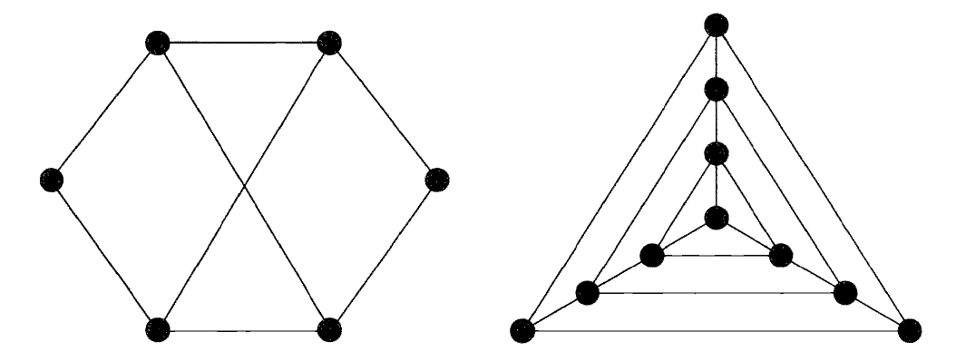








Example: Find Chromatic Number

Slide 8
Example
Find the upper bound given by Brooks’ Theorem for a) Petersen Graph b) k-cube Q_{k}.
a) Petersen Graph has Δ=3 so chromatic number can be max. 3.
b) Q_{k} has Δ=k so chromatic number can be max. k.

Slide 9













a b

Slide 10
The 4-color problem
This problem was first posed in 1852: Can we label faces of any simple planar graph using 4-colors?
Yes (Appel, Haken, 1976).

Slide 11
Example
A chemist has 5 chemicals a,b,c,d and e. Some chemicals explode when they contact each other, so they must be kept separate. A table shows the chemicals that must be separated.

Slide 12
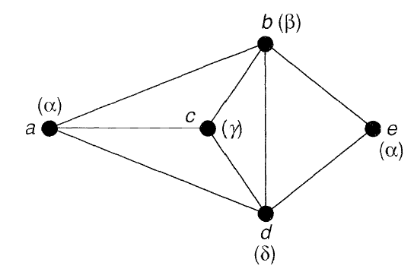
*: keep apart
 | a | b | c | d | e
a |  | * | * | *
b | * |  | * | * | *
c | * | * |  | *
d | * | * | * |  | *
e |  | * |  | *
Chemicals are vertices, which are connected if chemicals must be kept apart.
The graph is 4-colorable so we need 4 areas.

Slide 13
Coloring Maps
Graph coloring problem arises from an old question: How many colors are needed to color any given map so that no neighbors have the same color?

Slide 14
n-edge-connected graph
An n-edge-connected graph can be disconnected only if we delete n edges.
For example, a 3-edge-connected
(or 3-connected for short) graph needs at least 3 edges to be removed to get disconnected.

Slide 15











Example:
A map is a 3-connected plane graph:
All vertices have at least degree 3.
Not allowed!

Slide 16
Note
In planar graphs, we have seen how we convert faces of a graph G to vertices of a new graph G* using duality.
We must distinguish between k-colorability for faces or vertices. Using duality, we can convert a
face k-colorability(map) problem to a vertex
k-colorability problem.

Slide 17
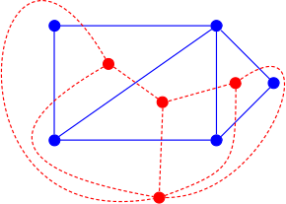
Dual Graph Example

Slide 18
Example:
G is 4-colorable(v)
G is 3-colorable(f)

Slide 19

Example:
Verify that the graph in the previous slide is 3-colorable(f) by showing that its dual(in this case abstract dual) is 3-colorable(v):
Notes:
--abstract dual: # of faces = # of vertices. In this case 5 faces in G* = 5 vertices in G and vice versa.

Slide 20

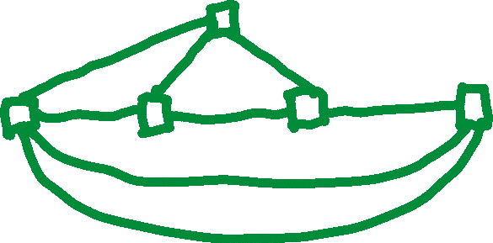
Example:
Show that G is 4-colorable(v) by showing that its abstract dual G* is 4-colorable(f):

Slide 21
Theorem
If G is a simple plane graph and G* is its dual, then G is k-colorable(v)if and only if G* is k-colorable(f).
If G is a simple plane graph and G* is its dual, then G is k-colorable(f)if and only if G* is k-colorable(v).

Slide 22
Coloring Edges
Let’s color the edges of a graph.
A graph G is k-colorable(e) if its edges can be colored with k colors so that no two adjacent edges have the same color.
Note that adjacent edges share a common vertex.
For edges, k is the chromatic index χ’(G)=k

Slide 23
Example: χ’(G) = 4

Slide 24
Vizing’s Theorem(1964)
If G is a simple graph and its largest vertex degree is Δ then χ’(G)= Δ or
χ’(G)= Δ+1.

Slide 25
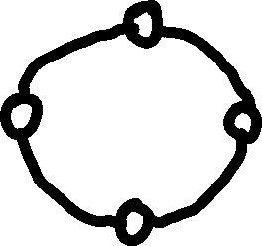

Cycle Graphs
χ’(C_{n})=2 if n is even and χ’(C_{n})=3 if n is odd.

Slide 26



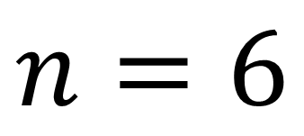










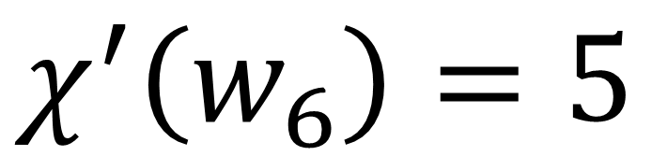
Wheel Graphs
χ’(W_{n})=n-1 if n>=4.
$$n=6$$
$$χ^{′}\left(w_{6}\right)=5$$

Slide 27







Complete Graphs
χ’(K_{n})=n if n is odd and n≠1 and χ’(K_{n})=n-1 if n is even.
$$n=4$$
$$χ^{′}\left(K_{4}\right)=3$$

Slide 28















K₅
Assign a color to each node, draw edges from that node using other colors.
$$n=5$$
$$χ^{′}\left(K_{5}\right)=5$$

Slide 29
K₅
$$χ^{′}\left(K_{5}\right)=5$$

Slide 30
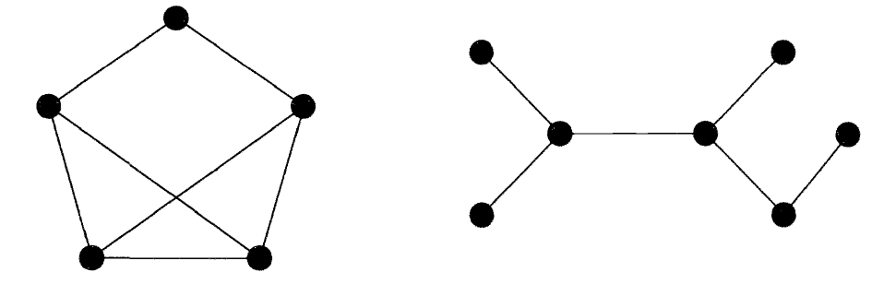






Example: Find Chromatic Index

Slide 31



Bi-partite Graphs
If G is a bi-partite graph with largest degree Δ then χ’(B)=Δ.
The complete bi-partite graph K_{r,s} has chromatic index χ’(K_{r,s})=max(r,s)

